Slide 1


The Basics of R Day 2 – Charts & Analysis
An Introduction to the R Programming Language for ADF&G Fishery Biologists
January 2021
Instructor: Justin Priest
https://github.com/justinpriest/R_Intro_ADFG/

Slide 2
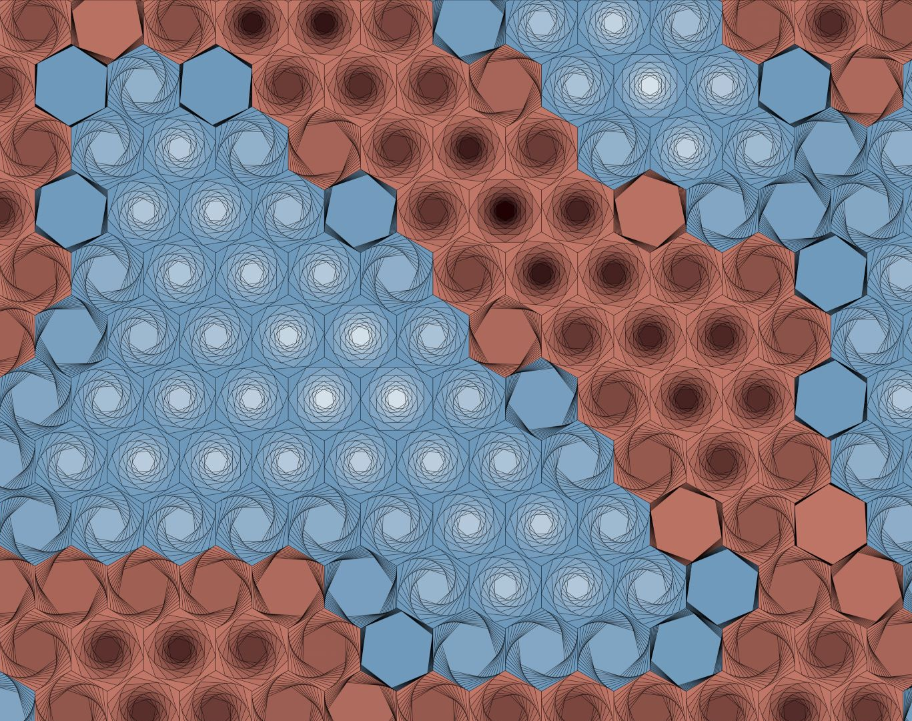
Welcome Back!
I’ve incorporated the feedback from Monday’s class: today we’ll focus more on charts and ggplot than analysis.
I want to reiterate how much progress you’ve already made!!
It can be frustrating to learn a language, but keep at it
Generative a{R}t by Thomas Lin Pedersen
Notes:
It is normal to feel like you’re stretching your brain and or not advancing as fast as you wish. I felt like that, everyone I’ve talked to felt like that.
This is a language, and you can’t learn Russian or train for a marathon in one day, keep practicing.
That said, you’ve learned a LOT more than you knew Monday morning

Slide 3
Today’s Agenda
09:00–11:30 Let’s Make Charts
11:30–12:00 Basic Analysis (presentation only)
12:00–13:00 Lunch
13:00–14:00 Project
14:00–14:30 & Tidyverse & Concluding Thoughts

Slide 4
A Brief Review

Slide 5
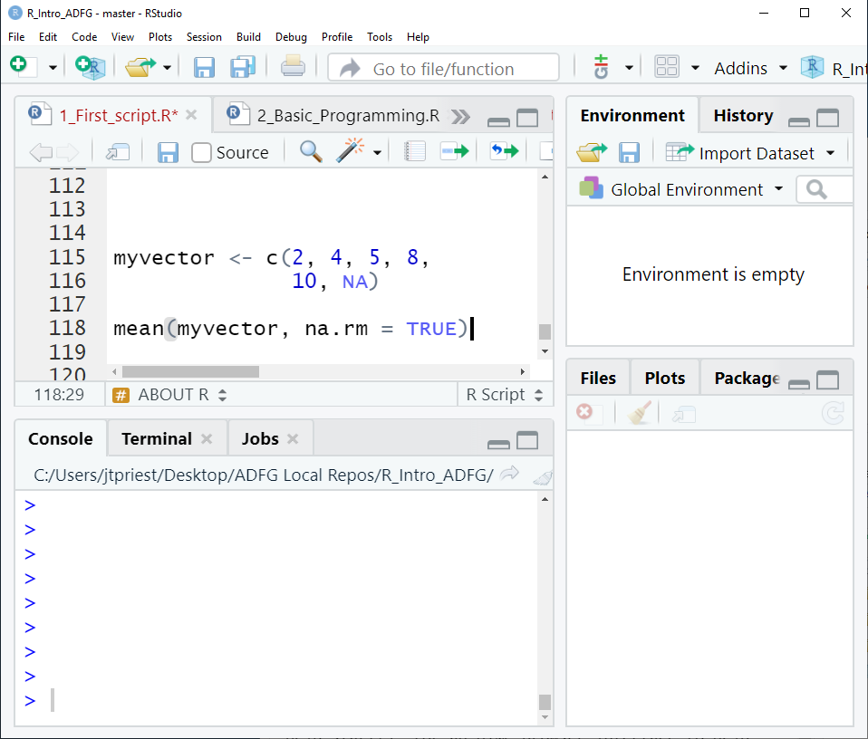
Review: General
A function has arguments
mean(dfname, na.rm = TRUE)
Use c() to concatenate items
Code lines must end in a comma, pipe, or be completed
function
data
argument

Slide 6
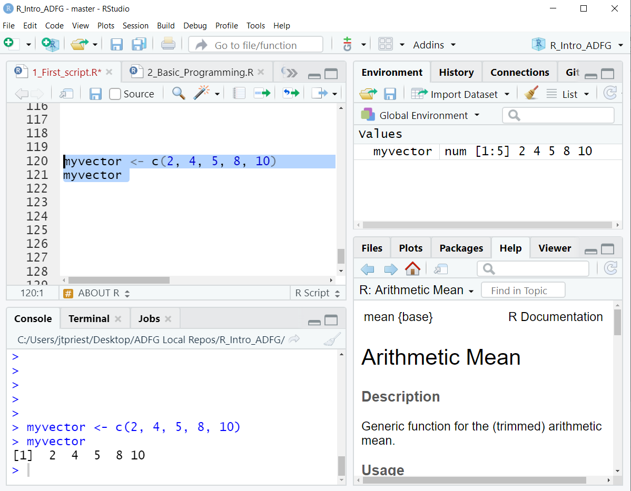
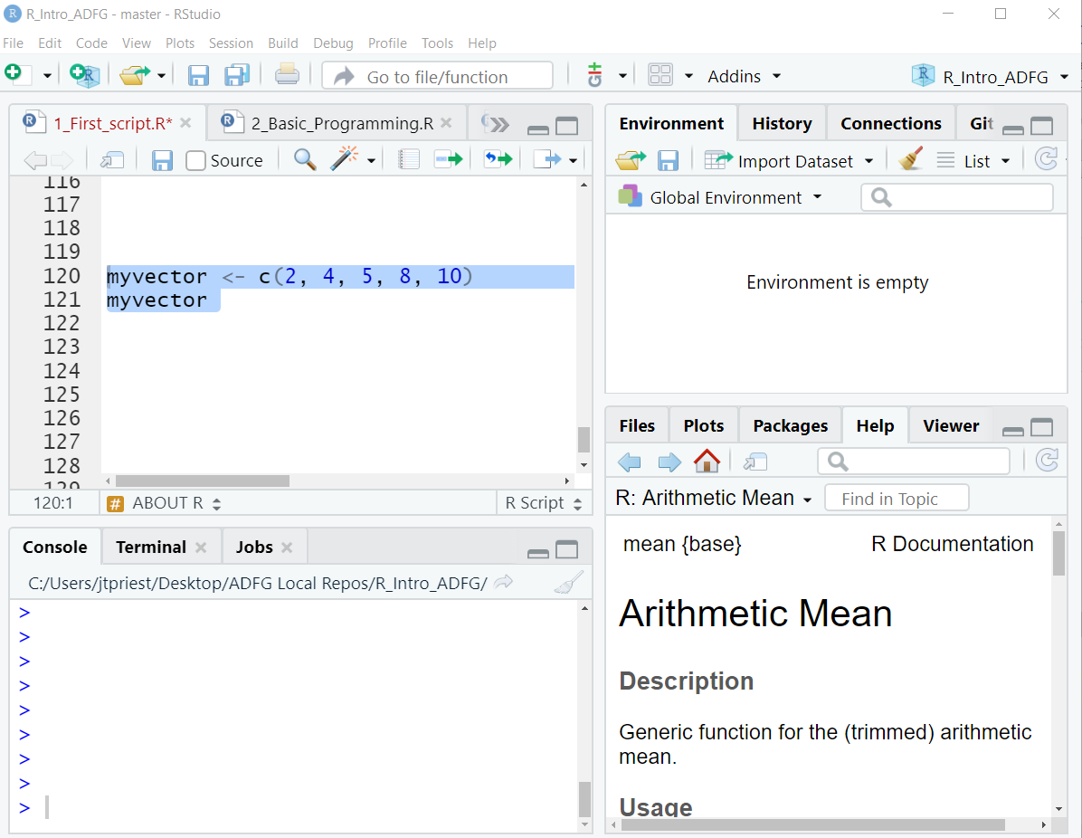
Review: General
Use “<-” to save a dataframe
Otherwise code doesn’t save for access later (which is often fine!)
Ctrl + Enter (or Run Button) evaluates the line of code (sending it to console)
Put cursor somewhere in that line, or highlight the chunk you want
Objects in the environment disappear once we close R. We’ll need to re-run whole script to get them back. They don’t “live” anywhere permanently.

Slide 7
Review: Libraries
Run once!
A library is a new group of functions
The first time, use install.packages(“packagename”)
Every time you open a script use library(packagename) to load a library
If you see:
> install.packages(“dplyr”)
> library(dplyr)
Run every time you open R
> library(idonthavethispkgyet)
Error in library(idonthavethispkgyet) :
there is no package called ‘idonthavethispkgyet’
Notes:
Once you install a package once, you can just use the library function. Otherwise you’ll have to write install.packages()

Slide 8
Review: Data
Reading in Data
Use read_csv(“subfolder/filename.csv”)
Problems? Did you use correct:
Filename
Subfolder name
Are you in the correct directory?
Use str() to check the types
Use View() to inspect dataframe
Data Cleanup
Keep certain rows: filter()
Keep certain cols: select()
Rename columns: rename()
Add new column: mutate()

Slide 9
Pipe %>%
dataframename <- filter(dataframename, Year == 2018)
dataframename <- mutate(dataframename, surveymonth = month(surveydate))
dataframename <- select(dataframename, Year, surveymonth, totalcount)
dataframename <- dataframename %>% filter(Year == 2018) %>%
mutate(surveymonth = month(surveydate)) %>%
select(Year, surveymonth, totalcount)

Slide 10
Creating a New Project
Let’s go over how to do everything from scratch!

Slide 11
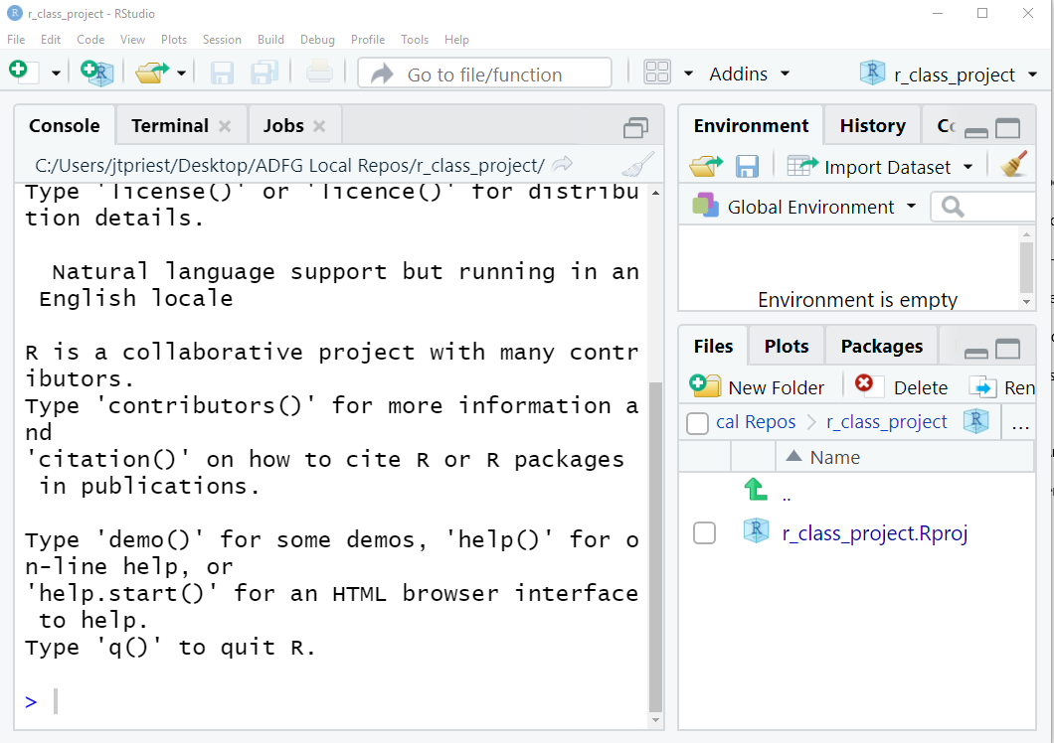
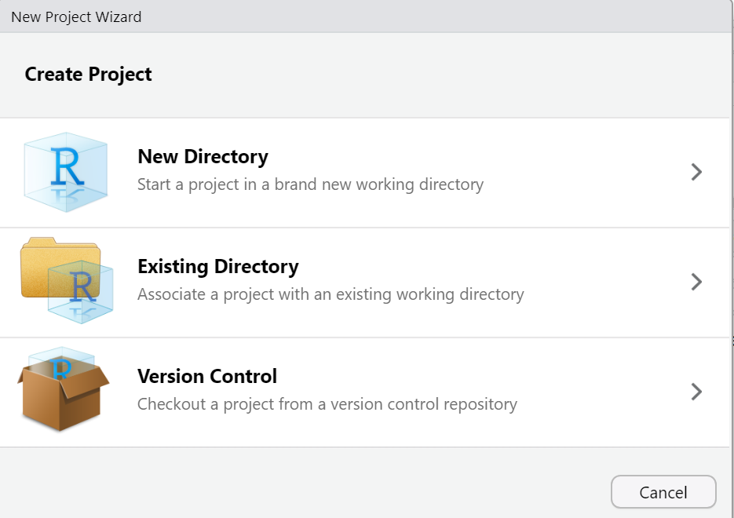
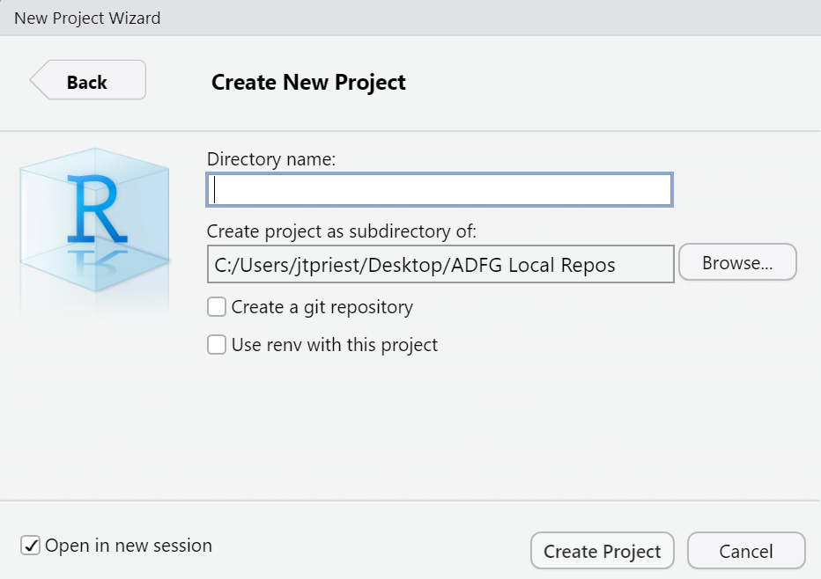
Create a Project
Open RStudio (any project or no project is fine)
File -> New Project
Do you want to create a folder?
Do you have an existing folder?
Choose New Project
Give it a memorable name (no spaces) and choose what folder you want it saved in
Success!
Notes:
I’ll go over how to start a New Di

Slide 12
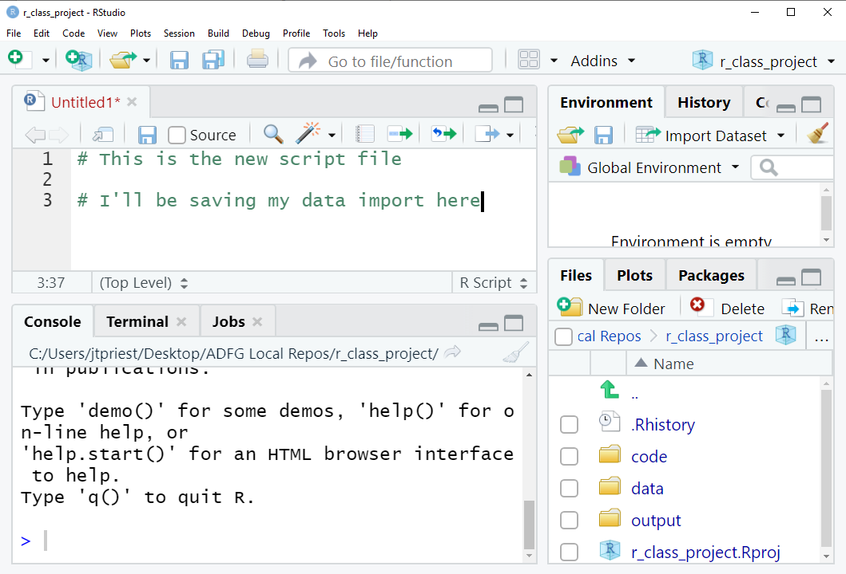
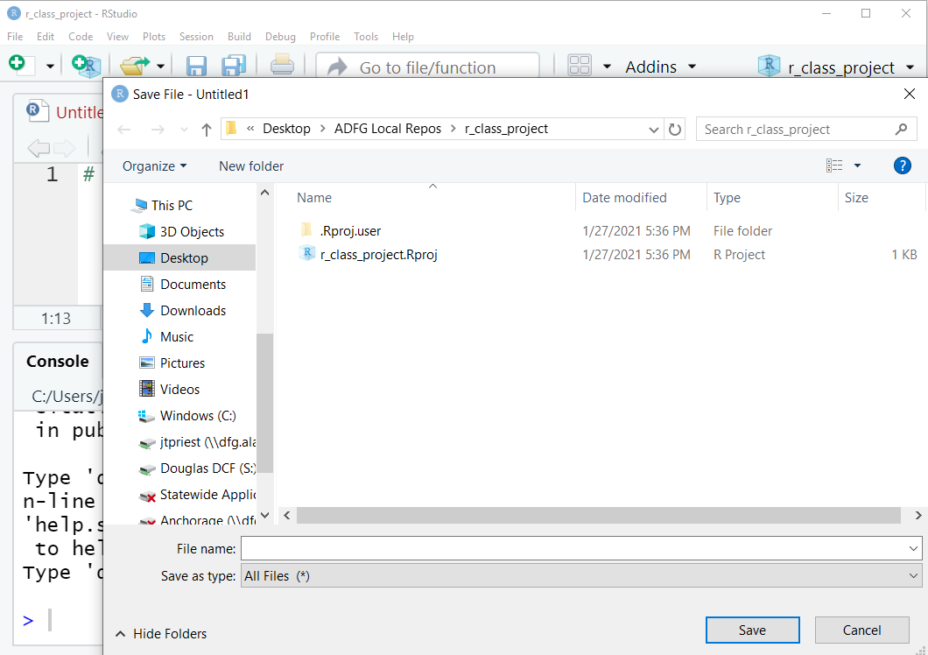
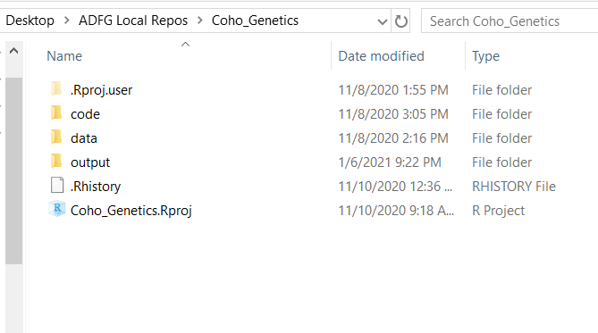
Create a Project, Part 2
File --> New File --> New R Script (Ctrl Shift N)
Write some code!
Save file but make a new folder called “code” first!
Open Windows Explorer folder. Create a folder named “data”, copy/paste some CSV files
Once completed, you should probably have something that looks like this

Slide 13
5 – Let’s Make Charts!
Charts and plots and graphs, oh my!

Slide 14
Chart Types
First, decide how to present your data
Are you looking to show:
Trend over time
Composition
Compare / contrast
Distribution
Relationship
Often, I find it most useful to sketch out on paper what I want to see beforehand!

Slide 15
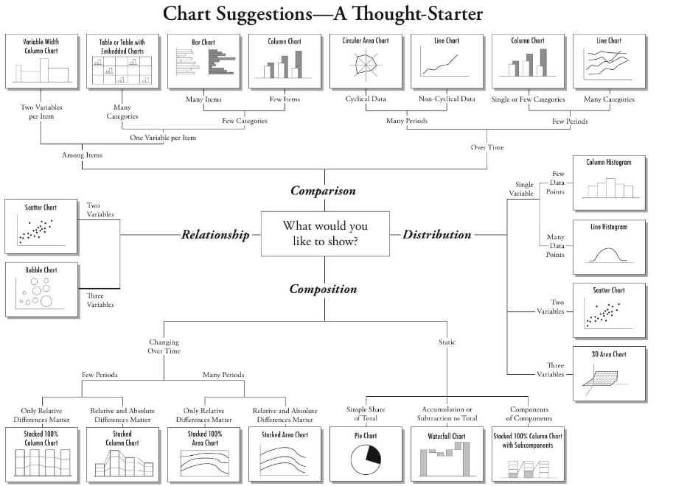
Chart Types

Slide 16
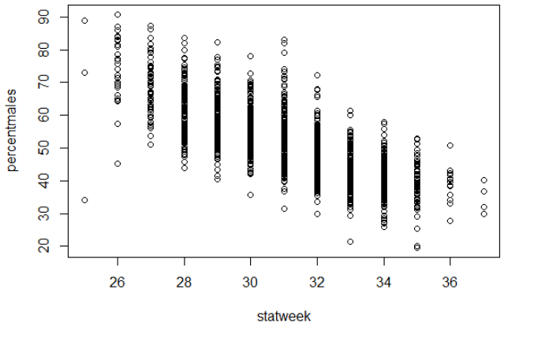
Chart Basics
Use base function plot()
Syntax is plot(yaxiscolumn ~ xaxiscolumn, data = dataname)
OR alternately: plot(x = dataname$xaxiscolumn, y = dataname$yaxiscolumn)
Using plot() is very quick and easy!
plot(percentmales ~ statweek, data = pinkratio)

Slide 17
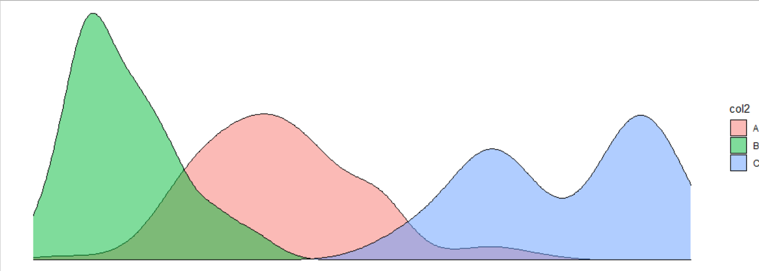
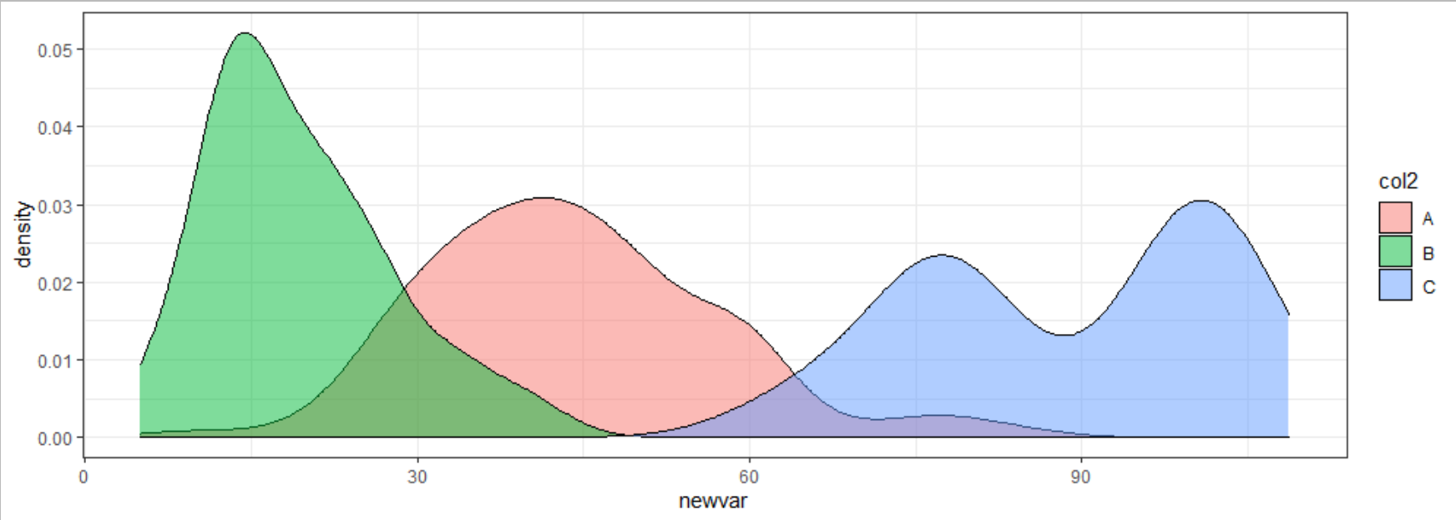
ggplot2 – A Better Way
Why use ggplot2 over base plot?
Faster to hit ground running
If you make anything beyond basics, it’s easier
I’ll call it just ggplot. What happened to ggplot1? Nobody knows…..
Notes:
We’re getting ahead of ourselves: ggplot2 is part of the “tidyverse” group of packages. We’ll learn more about them later today

Slide 18
ggplot2
ggplot() function with data & aes()
aes() is the “aesthetics”. Set which cols are equal to x, y, color, fill, and group.
Use a “+” to connect between lines
Control aspects of the axes (and other parts) with “scale_”, e.g., scale_y_continuous, scale_x_discrete
Add points & lines using “geom_”
e.g., geom_point(), geom_line(), etc
Set visual elements using theme()
Establish the plot
ggplot(data = mydataframe, aes(x = xcolumn, y = ycolumn, group = groupvar))
scale_x_continuous(breaks = c(1990, 2000, 2010, 2020)) +
geom_line()
+
Control x axis (e.g., set axis breaks)
Create lines!
Notes:
We build up a ggplot object layer by layer
This is a roadmap to the topics that we’ll discuss here shortly: we’re going to talk about the aes() function, what geoms are,
A grouping variable would be analogous to “series” in Excel. For example, if you want multiple lines, tell ggplot what column you want it based on. Maybe a different line for each river

Slide 19
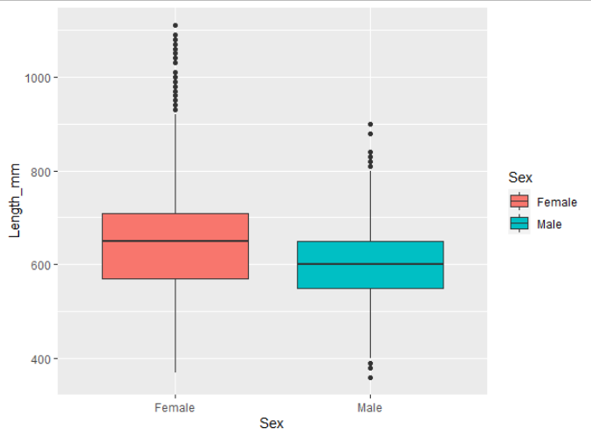
Anatomy of a ggplot
Establish which dataframe to look at
ggplot(data = sablefish,
aes(x=Sex, y = Length_mm,
fill = Sex)) +
geom_boxplot()
ggplot(data = sablefish,
aes(x=Sex, y = Length_mm,
fill = Sex)) +
geom_boxplot()
“Sex” should be along x-axis, with length on y
Fill the objects based on the Sex column
Three required parts:
ggplot(data = xxx, aes()) +
geom_xxx()
Create a boxplot!
Notes:
Note also that our plot must be internally consistent! What if variable “Sex” was a numeric variable instead of a categorical? We couldn’t make a boxplot

Slide 20
ggplot parts: ggplot()
Two parts of ggplot(): data and aesthetics
Establish data using data =
Use aesthetics to “map” different variables to the x-axis, y-axis, fill, color, group (series), etc.
Done within the aes() function
Technically, specifying the data and the aes() could happen within the geom_xxx()
ggplot(data = mydataframe,
aes(x = xcolumn, y = ycolumn, group = groupingvariable))
The aes() function can contain other parts:
shape = variable,
fill = variable,
color = variable,
alpha = variable

Slide 21
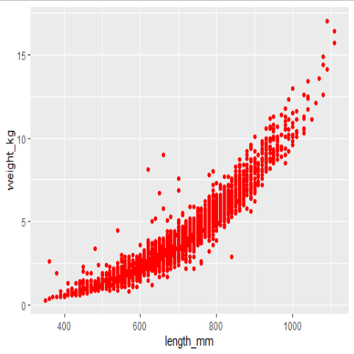
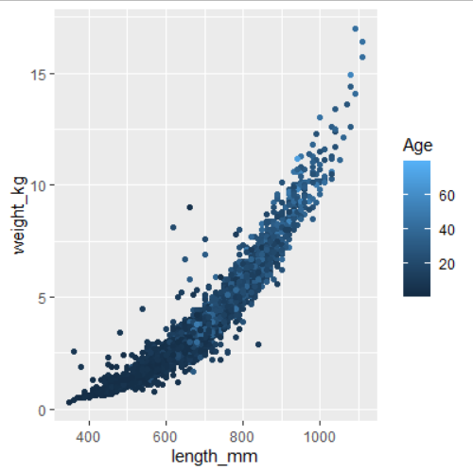
ggplot parts: aes()
It can be tricky to wrap your head around the aes function
Make sure to keep the aes() inside the ggplot()
Anything that is static goes OUTSIDE the aes(), in geom
Anything dynamic (changes according to a variable) goes INSIDE the aes()
Static: color does not change
Dynamic: color changes by variable
ggplot(sablefish, aes(x=length_mm, y = weight_kg)) +
geom_point(color = "red")
ggplot(sablefish, aes(x=length_mm, y = weight_kg, color = Age)) +
geom_point()

Slide 22
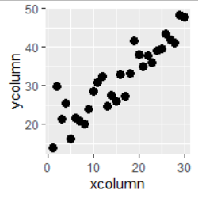
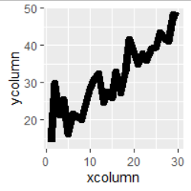
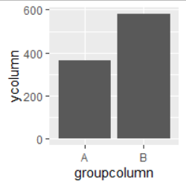
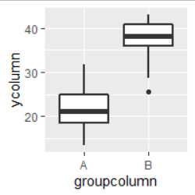
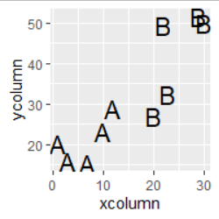
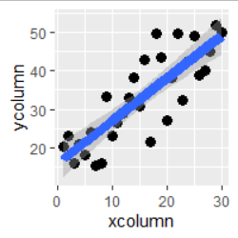
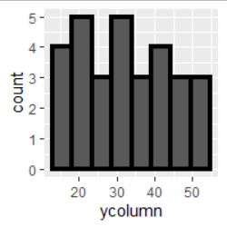
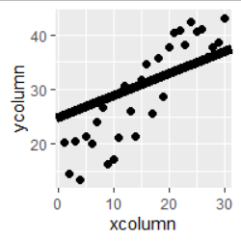
ggplot parts: geoms
Plot Type & Notes:
Tell ggplot what kind of plot you’d like:
Basic scatterplot. Typical arguments
Basic line. Typical arguments
Scatterplot but use text instead of symbols.
Add linear or LOESS smoothing. Use method = “lm” or method = “loess”
Basic bar (columns). “fill” is the bar color, color is bar outline
geom_point()
geom_line()
geom_col()
geom_boxplot()
Add a boxplot, x is categorical
Histogram. No y-axis specified in aes()
Add straight line with arguments slope = 1, intercept = 0.
geom_text()
geom_point() + geom_smooth()
geom_histogram()
geom_point() + geom_abline()
Notes:
Reference guide: http://sape.inf.usi.ch/quick-reference/ggplot2/geom

Slide 23
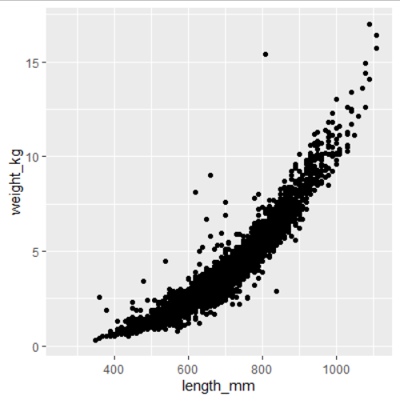
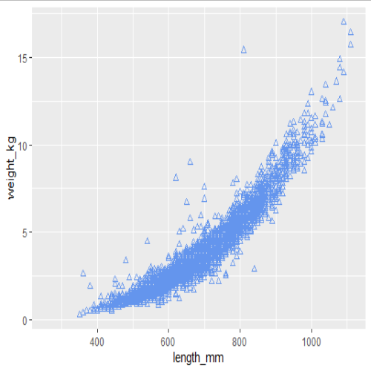
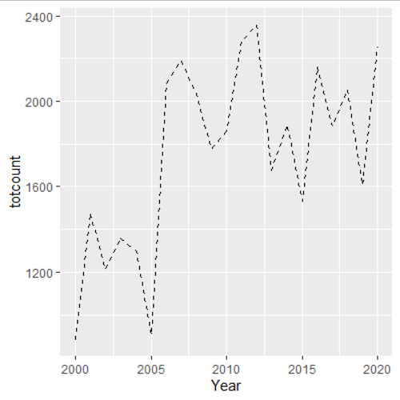
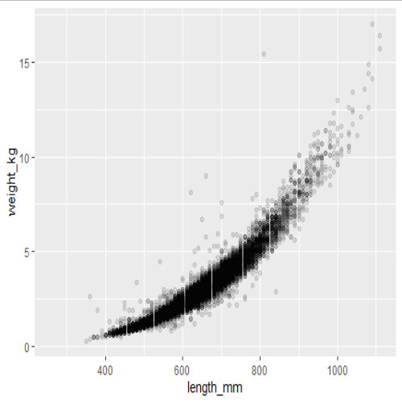

ggplot parts: geoms
To modify this plot, common arguments within a geom are:
color
shape (only for geom_point)
alpha (transparency)
linetype (only for geom_line)
ggplot(sablefish, aes(x=length_mm, y = weight_kg)) +
geom_point()
ggplot(sablefish, aes(x=length_mm, y = weight_kg)) +
geom_point(color = "cornflowerblue")
ggplot(sablefish, aes(x=length_mm, y = weight_kg)) +
geom_point(color = "cornflowerblue", shape=2)
ggplot(sablefish, aes(x=length_mm, y = weight_kg)) +
geom_point(alpha = 0.1)
ggplot(data = totalsablefish, aes(x=Year, y = totcount)) +
geom_line(linetype = 2)
Notes:
Notice that none of these are within the aes()

Slide 24
ggplot parts
So far, so good! These are the minimum parts required of a ggplot
ggplot(data = dataframename, aes(x=xcolumn, y=ycolumn)) + geom_xxx()
What if we want to clean up the plot, specify colors, or change axis labels, etc.?
Now we’ll learn about adding more parts
Add lines together with a “+”

Slide 25
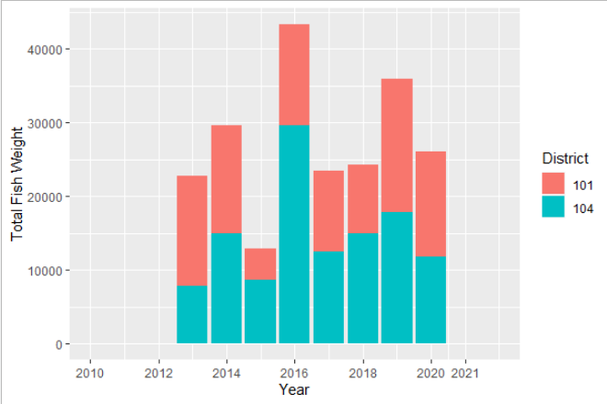
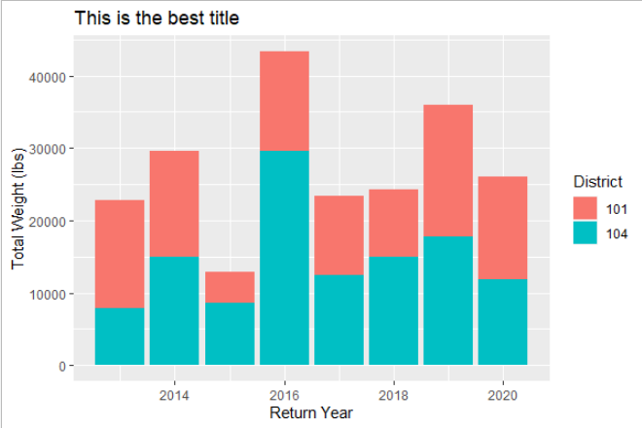
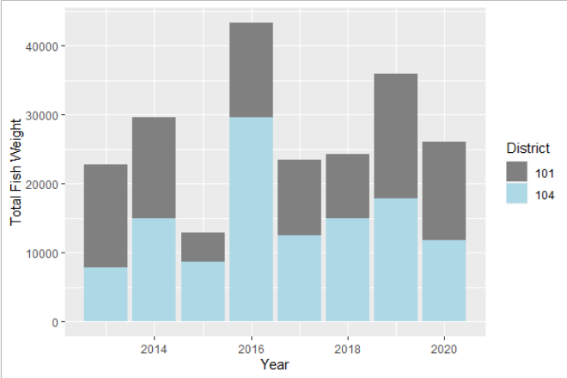
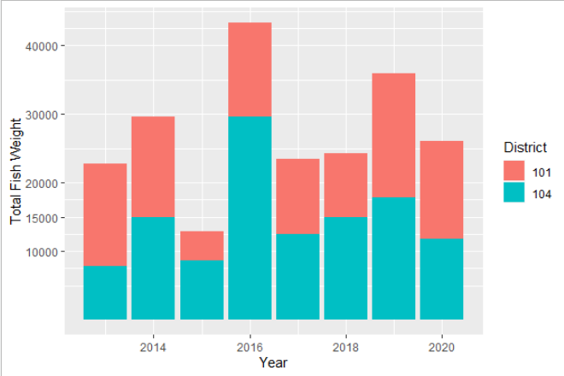

ggplot parts: scales
The scale_ family are helper functions to control aspects such as specifying variable colors, variable fills, axis range / breaks, etc.
Far too many to review
To change axis labels or title, use labs()
labs(x = "Return Year", y = "Total Weight (lbs)", title = "This is the best title")
expand_limits(x = c(2010, 2022)) +
scale_x_continuous(breaks = c(2010, 2012, 2014, 2016, 2018, 2020, 2021))
No modified scales
scale_y_continuous(breaks = c(10000, 15000, 20000, 30000, 40000))
scale_fill_manual(values = c("#808080", "lightblue"))
Notes:
There are too many types of scales to list.

Slide 26
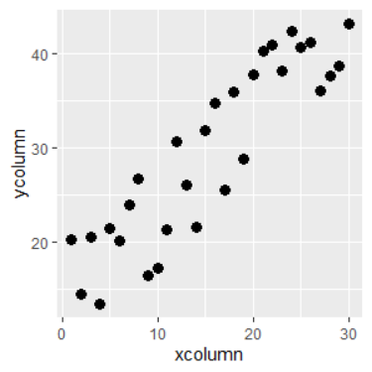
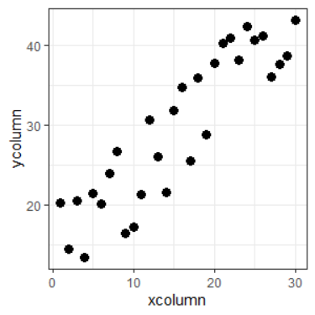
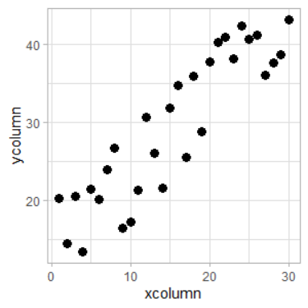
ggplot parts: theme
To modify the appearance of text, axis lines, legend, etc., use theme()
There are several built in themes
theme_bw()
theme_minimal()
theme_classic()
theme_light()
I never remember how to do most theme modifications and google it
default
theme_bw()
theme_light()

Slide 27
ggplot parts: theme
Some common theme() changes:
Rotate x axis text
Increase font size & change font
Move legend position & remove legend title
theme(axis.text.x = element_text( angle = 45, vjust=1, hjust=1)
library(extrafont)
theme(base_size = 12, base_family = “Arial”)
theme(legend.position=c(0.5, 0.05), legend.title = element_blank())

Slide 28
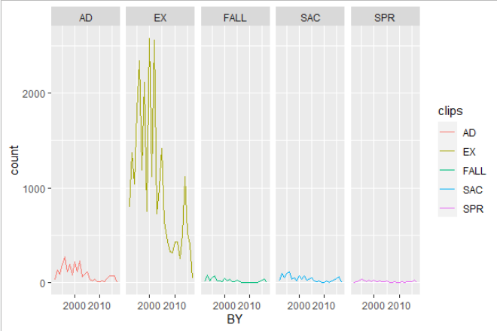
ggplot parts: Facets
One amazing feature of ggplot is the ability to create a different plot for specific subsets of a variable
Use command facet_wrap(~variable) or facet_grid(~variable)
You could even facet it based on two variables:
facet_wrap(variable1 ~ variable2)

Slide 29
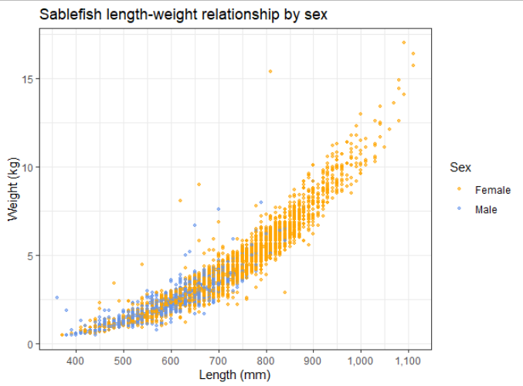
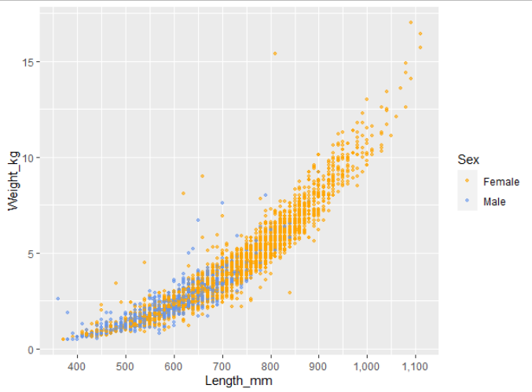
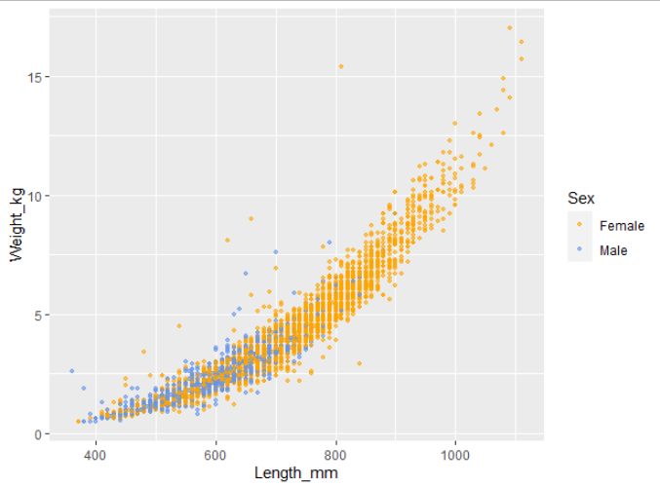
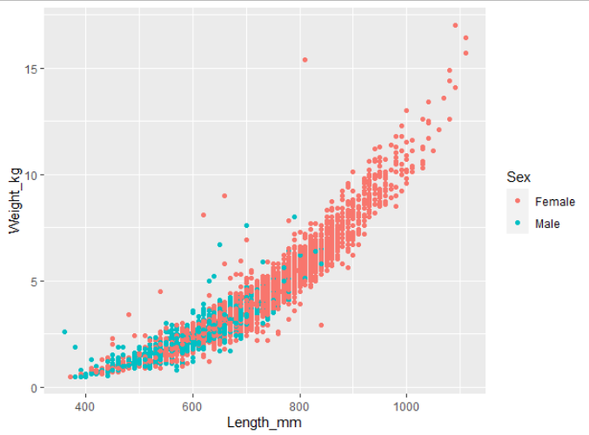

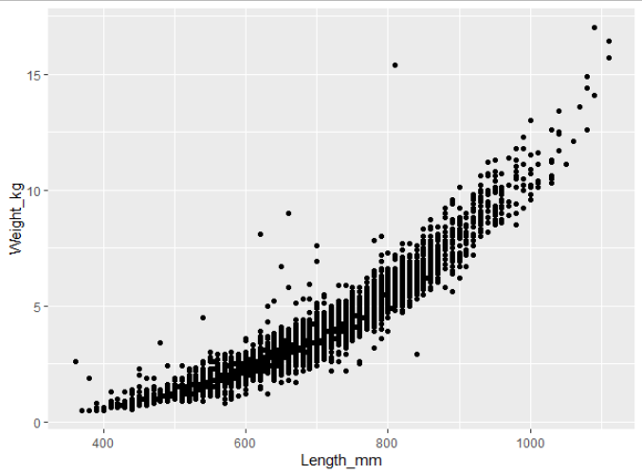
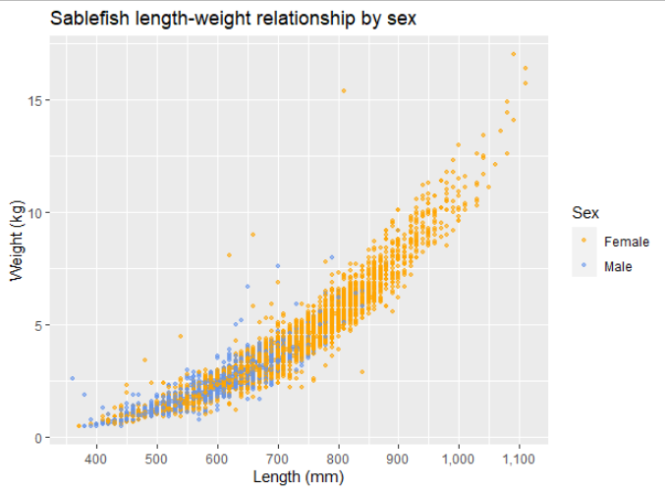
Anatomy of a ggplot
> ggplot(data = sablefish, aes(x = Length_mm, y = Weight_kg)) +
geom_point()
> ggplot(data = sablefish,
aes(x = Length_mm,
y = Weight_kg,
color = Sex)) +
geom_point(size = 0.9, alpha = 0.6) +
scale_color_manual(values =
c("orange", "cornflowerblue")) +
scale_x_continuous(breaks = c(400,
500, 600, 700, 800, 900, 1000,
1100, 1200), labels = scales::comma) +
labs(x = "Length (mm)", y = "Weight(kg)",
title = "Sablefish length-weight
relationship by sex")
> ggplot(data = sablefish,
aes(x = Length_mm,
y = Weight_kg,
color = Sex)) +
geom_point(size = 0.9, alpha = 0.6) +
scale_color_manual(values =
c("orange", "cornflowerblue")) +
scale_x_continuous(breaks = c(400,
500, 600, 700, 800, 900, 1000,
1100, 1200), labels = scales::comma) +
labs(x = "Length (mm)", y = "Weight(kg)",
title = "Sablefish length-weight
relationship by sex") +
theme_bw()
> ggplot(data = sablefish,
aes(x = Length_mm,
y = Weight_kg,
color = Sex)) +
geom_point(size = 0.9, alpha = 0.6) +
scale_color_manual(values =
c("orange", "cornflowerblue")) +
scale_x_continuous(breaks = c(400,
500, 600, 700, 800, 900, 1000,
1100, 1200), labels = scales::comma)
> ggplot(data = sablefish,
aes(x = Length_mm,
y = Weight_kg,
color = Sex)) +
geom_point(size = 0.9, alpha = 0.6) +
scale_color_manual(values =
c("orange", "cornflowerblue"))
> ggplot(data = sablefish,
aes(x = Length_mm,
y = Weight_kg,
color = Sex)) +
geom_point()
> ggplot(data = sablefish,
aes(x = Length_mm,
y = Weight_kg,
color = Sex)) +
geom_point(size = 0.9, alpha = 0.6)
Notes:
Predict what next plot will be!

Slide 30
Plotting Approach
When starting out, it’s tempting to paste a lot of code from a previous figure or something you found online.
If you can, try not to do this. A better approach is to build it step by step, line by line.
Add just the skeleton, e.g., ggplot(aes()) + geom_line(), and build out
This will immediately identify where errors exist

Slide 31
Fill vs Color
Remember to keep in mind the difference between “fill” and “color”
“Fill” fills in an area (bar column)
“Color” is the point or line
If specifying manually, these take different commands depending on discrete vs continuous data
FILL an area
COLOR a line or point

Slide 32
Fill vs color
 | Color | Fill
Continuous | scale_color_gradientn(colors = c()) | scale_fill_gradientn(colors = c())
Categorical | scale_color_manual(values = c(“xxx”)) | scale_fill_manual(values = c(“xxxx”))
Example Code:
scale_color_gradientn(colors = terrain.colors(10))
scale_fill_gradientn(colors = terrain.colors(10))
scale_color_manual(values = c("orange", "cornflowerblue"))
scale_fill_manual(values = c("orange", "cornflowerblue"))
Notes:
Reference only
Mainly, I just want you to know for the future that you need to specify differences between continuous and categorical variables

Slide 33
Saving!

Slide 34
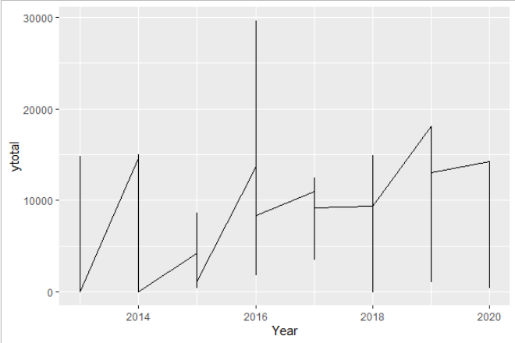
Common ggplot errors
The most common errors I see are:
What goes inside vs outside aes()
Items inside aes() are variables (changeable), outside are static
Jagged lines
You have multiple y points for each x point. Add a “group = variable2” to plot a line for each group
Color vs Fill
Easy mistake, remember the difference
Overwriting a theme
ggplot will use the last theme settings you gave it

Slide 35
Let’s practice
In RStudio, we’ll run through the script. Please ask questions!
If you need another explanation later, Dr. Lendway’s videos are great!
Intro to ggplot() – 8 min
Common ggplot mistakes – 3 min
ggplot demo – 32 min
These videos support material on her learning website

Slide 36
6 – Basic Analysis
Because using 30-year-old Excel macros is so yesterday

Slide 37
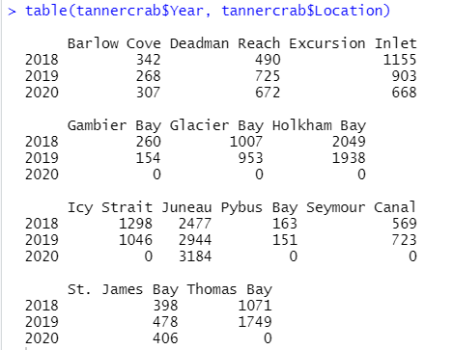
Data Summary: table()
Quickly summarizes dataframe
table() makes a 1-way (1 variable) or 2-way summary table of all counts by variable
table(variable1, variable2)

Slide 38
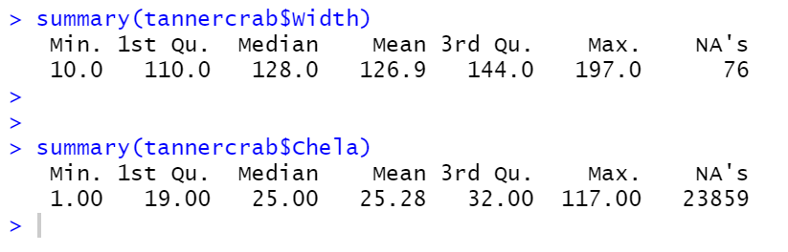
Data Summary: summary()
summary() is a quartile distribution of your continuous data

Slide 39
Summarize Data: group_by()
group_by() %>% summarize()
Together, these are like a pivot table
group_by() can be used to produce grouped calculations in mutate()
Very fast and useful way to view data summaries
> dataframename %>%
group_by(Year, statweek) %>%
summarize(newcolname =
mean(variable1))
Output:
For each year & statweek, what is the mean of variable1?
(New summary column is named “newcolname”)
Notes:
I use group_by() %>% summarize() all the time!!

Slide 40
ANOVA
ANOVAs test whether categorical variables have different continuous distributions. For example:
Is mean length significantly different between species?
Different mean weights between years?
Use aov() and NOT anova()
Remember that there are some items to be aware of for an ANOVA (type I, II, & III). More ANOVA info here
The Anova() function from package “car” allows specifying type!
Notes:
It is very quick and easy to produce an ANOVA in R

Slide 41
Linear Modeling
Modeling a linear trend in R is EASY!
lm(response ~ independentvar, data =df)
Save this output or wrap in summary()
Multiple variables are easy too:
lm(response ~ var1 + var2, data =df)
R notation:
lm(y ~ var1)
Formula notation:
y = β₀ + β₁var1
=
lm(y ~ var1 + var2)
y = β₀ + β₁var1 + β₂var2
Notes:
Your response, independent variable 1, and independent variable 2 will all be in different columns

Slide 42
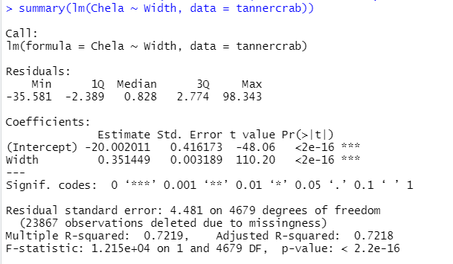
Reading lm() output
Formula
Residual diagnostics
Estimate = β₀ , β₁
Std. Error & t value
Pr(>|t|) = p-value
R²

Slide 43
Project
Use a provided dataset (or bring your own) to create a visualization

Slide 44
Project Goal
When we come back from lunch, create and save a script that does the following:
Imports your dataset or one of the provided CSV files
Loads needed libraries
Filters to a specific subset of data (optional)
Using ggplot, visualize some aspect of the data
Use the template, or create your own project / script
Remember! It’s OK to Google how to do something. I do it for EVERY script

Slide 45
Project Steps
Choose a dataset
Open in Excel to look at data
Use provided template or create a new directory/project
Copy over all needed files
Create & save a blank script file
Import data into R
Perform needed data manipulation
View data, decide what to visualize
Plot in ggplot (and troubleshoot along way)
If you finish early, you can:
Message & help others
Make more plots
Google other “touch ups”
Do some simple analysis / summaries
If you feel like you’re not making progress that’s fine! Message me or a peer ☺

Slide 46
Example Projects
Some example projects that you could do are:
Tanner crab chela width vs crab width
Pink salmon harvest by district
You are welcome (and expected) to copy code over that we’ve done together. Read error statements closely. Google your problems.
If you want to pair up and work on the same dataset, it’s great to talk it out and share code! However, write as much individually as you can: the more you write, the more the ideas are cemented

Slide 47
Lunch Break
See you all at 1 PM

Slide 48
Work on Projects
Good luck! I’ll try to help as many people as possible during this time
Start simple, work up to complicated.
Send me some of your plots by email / chat!

Slide 49
Project Steps
Choose a dataset
Open in Excel to look at data
Create a new directory/project & copy over all needed files (not required but helpful if you want to use this later)
Create & save a blank script file
Import data into R
Perform needed data manipulation
View data, decide what to visualize
Plot in ggplot (and troubleshoot along way)

Slide 50
Chart Presentation
Present plots

Slide 51
Plots

Slide 52
7 - Tidyverse
It’s like R, but different. And better. Definitely better.
Reference only – Just know this info is here and come back in the future!

Slide 53

What is the Tidyverse
The Tidyverse is a collection of packages that extend the usefulness of R, use slightly different language syntax, and play well together
Some of the most common Tidyverse packages are:
dplyr – data manipulation (mutate, select, filter, summarise)
ggplot2 – produce beautiful charts
tidyr – change data layout to one observation per row, and inverse
lubridate – work with dates
And several others!
Loaded with
library(tidyverse)
Notes:
We previously used some of these earlier: dplyr is amazing for data manipulation and ggplot2 is amazing for plotting

Slide 54

Why Use the Tidyverse?
It’s often simpler to read: filter(Year == 2010)
Forces cleaner data which will save you time later
Makes certain data types workable (e.g., dates)
More powerful features
Constantly updated (future of R?)
Downside
Syntax is slightly different and you’ll know two different ways to do same thing

Slide 55

dplyr
Already learned about most of these functions
Introduces the “pipe” operator %>%
Add a new column using mutate(), choose specific rows based on column values using filter(), change whether a column is included using select(), change column names using rename()
**warning** you may find code online that uses the previous version of this package called “plyr”. If you find a function that uses plyr, I highly recommend not using it if you use “dplyr”. The two packages can (rarely) have major issues with each other.
Notes:
We’ve covered most of these previously because they’re so useful!

Slide 56
dplyr
join functions add datasets together based on common columns
Most often, I use left_join()
dfname1 %>% left_join(dfname2, by = c(“Year” = “Yr”))
Year | Var1 | Catch
2010 | A | 10
2010 | B | 30
2011 | A | 5
2011 | B | 50
2012 | A | 15
Yr | Rain
2010 | 0.5
2011 | 0.1
2012 | 1.2
Year | Var1 | Catch
2010 | A | 10
2010 | B | 30
2011 | A | 5
2011 | B | 50
2012 | A | 15
Rain
0.5
0.5
0.1
0.1
1.2
left_join()
dfname1
dfname2

Slide 57
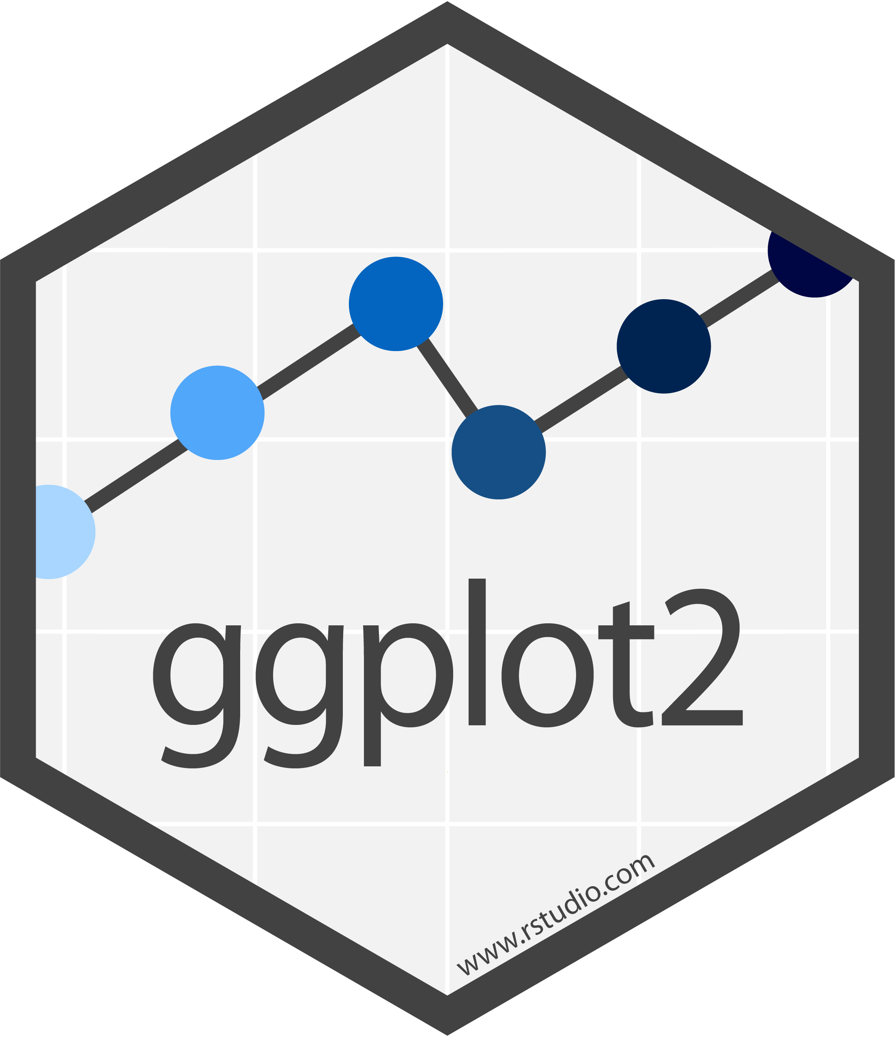
ggplot2
The most popular way to plot in R
Uses a “grammar of graphics” which takes a bit to learn
The basic structure is defining the source dataframe, the aesthetics (variables for x axis (& y axis), variables for color/shape, etc), and then a call to what type of plot you’re making (points, lines, histogram, etc)
Strings together commands using “+” between the lines
Notes:
All covered previously

Slide 58

lubridate
Dates are probably the most difficult thing to deal with when starting out in R.
lubridate provides a better interface; can easily convert between date formats, subtract time periods, calc day of year, etc.
For “11/12/12”, what is the month? Are you sure?
Excel is great at dealing with dates but it isn’t perfect either

Slide 59
lubridate examples
Example 1: Convert “11/12/2020” to a date (12 Nov 2020)
Answer 1:
mutate(newdate = ymd(as.POSIXct(olddate, format = "%m/%d/%Y", tz = "US/Alaska"))
Example 2: Convert “2020-12-31” to a date (31 Dec 2020)
Answer 2:
mutate(newdate = ymd(as.POSIXct(olddate, format = "%Y-%m-%d", tz = "US/Alaska"))
This is the format of the existing data NOT the format you want it in
Notes:
Use the code here as a template for your future code

Slide 60
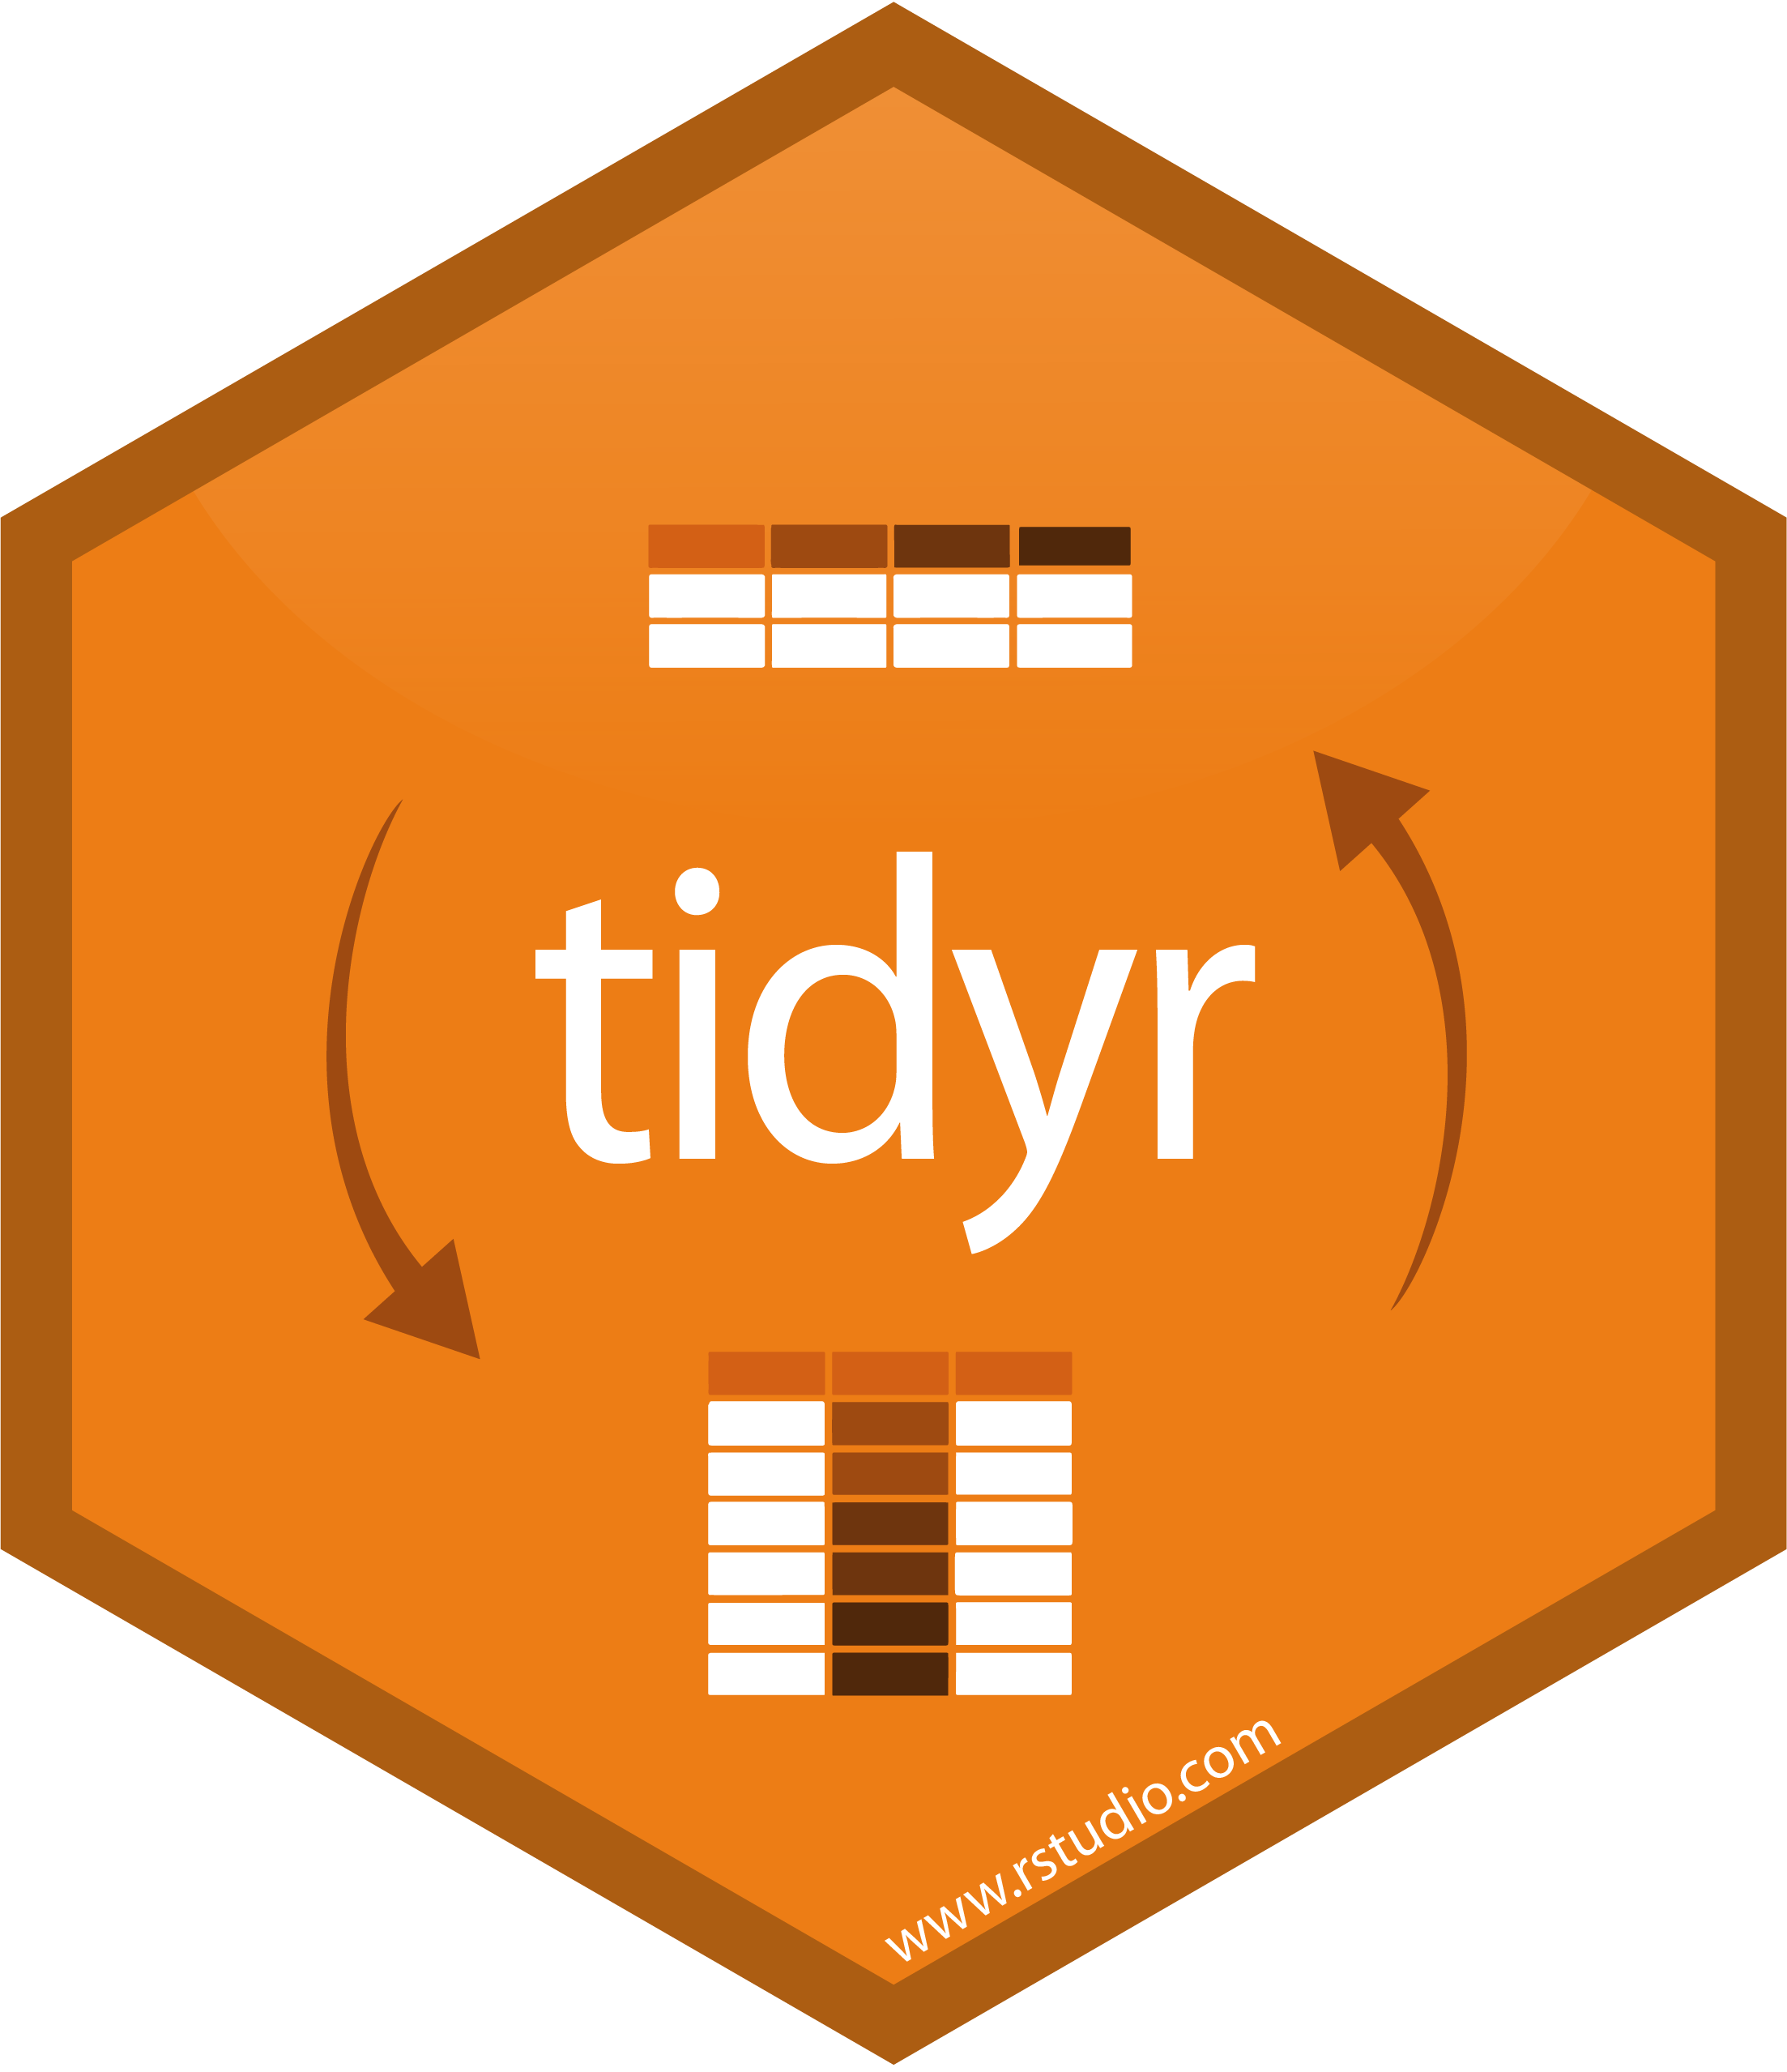
tidyr
tidyr is a package whose main functions help to turn “wide” data into “long” data and vice-versa
pivot_wider() and pivot_longer()
These two easily turn data from wide to long (pivot_longer) or from long to wide (pivot_wider)
When possible, keep data in long format to model / plot easier

Slide 61
tidyr example
dataframename %>%
pivot_longer(-leavethiscolumn, names_to = “newcolname”, values_to = “whatcellvaluesare”)
Year | StreamA | StreamB
2011 | 300 | 500
2012 | 150 | 450
2013 | 200 | 375
2014 | 120 | 450
Year | River | Count
2011 | StreamA | 300
2011 | StreamB | 500
2012 | StreamA | 150
2012 | StreamB | 450
2013 | StreamA | 200
2013 | StreamB | 375
2014 | StreamA | 120
2014 | StreamB | 450
pivot_longer()
dataframename %>%
pivot_longer(-Year, names_to = “River", values_to = "Count")

Slide 62
Concluding Thoughts
Some miscellaneous best practices and ways to have a smoother R experience

Slide 63


Workflow
When starting out, it’s common to manipulate your data in Excel, save this file, then import/analyze in R
There is nothing wrong with this and if it works for you, great!
It’s MUCH better though to do all this in R
Saves steps for cleanup that is performed each time

Slide 64
Best Practices
R is not that great for tables but is excellent for figures
Don’t use spaces in filenames or directories if you can
Name files descriptively
Use easy to understand variable names; don’t overwrite
Break up your data import / cleanup & analysis scripts
Use several scripts that “link” together rather than one long one
Comment often and be VERY thorough, I promise that you’ll experience frustration at yourself for not being clearer
“Always comment your code as if the person who reviews your code will be a violent psychopath who knows where you live”
Surprise!
It’s going to be you…

Slide 65
Best Practices, cont.
Update your R version and packages often
Unless you’re about to publish and need absolutely nothing to change
Follow people on GitHub / Twitter to read other people’s code and learn better coding practices
Read in data using .csv files (unless already in relational DB), never use file.choose(), never use the “Import Dataset” wizard in RStudio. Keep file paths relative and not static
Use “Projects” in Rstudio to keep scripts organized

Slide 66




Not Covered
So many things weren’t covered but some of the more interesting are:
GitHub – Can sync your files to the internet which makes life MUCH simpler, especially if you are collaborating. Highly recommended
Rmarkdown – Create PDF, HTML, Word etc. files embedded with your R script outputs. Allows automatic report creations.
Shiny – This package allows for the creation of interactive apps
Spatial Analysis – Unique enough analyses to warrant its own discipline. If you can do it with ArcGIS, you can probably do it with R

Slide 67
Parting Thoughts
Like any language, becoming familiar with R requires a little practice over a long period of time. It’s easy to get discouraged initially.
Keep googling your problems: it’s very unlikely that you’re the first with this issue. I still google how to do something almost every other line of code.
Programming is not the same as asking the right questions: learn more statistics! It is possible that you are attempting analysis that is best accomplished differently. Or worse, doing something you shouldn’t.
Notes:
However, unlike spoken languages, you can take your time! It took me 10 minutes to write a line of code before. It’s OK to go slow.
For me, the best way to motivate myself to learn was having my own dataset to work through; for others, online tutorials were best.
Even the best programmers still google and read Stack Exchange.

Slide 68

Congrats!
This certificate is good for a free R help session, one-on-one!
Plus, you’re always welcome to ask me for help; the worst I can say is I’m busy
Notes:
I really enjoy helping people with their R questions. Please message me

Slide 69
Resources
Just Starting Out – Teach yourself!
https://datacarpentry.org/R-ecology-lesson/00-before-we-start.html
Learnr tutorial about NAs
Learnr tutorial about filtering
Learnr tutorial about summarizing
https://r-bootcamp.netlify.app/
https://rstudio.cloud/learn/primers
https://ggplot-dplyr-intro.netlify.app/
Just Starting Out - Comprehensive
In-depth Resource 1
In-depth Resource 2
Similar layout to class!

Slide 70
Resources
Data Management
Data Organization in Spreadsheets
https://annebeaudreau.com/2018/02/04/data-management-tips/
Workflow
https://whattheyforgot.org/project-oriented-workflow.html
https://www.tidyverse.org/articles/2017/12/workflow-vs-script/

Slide 71
Resources
Style Guides
http://r-pkgs.had.co.nz/style.html
https://google.github.io/styleguide/Rguide.xml
Statistics
http://www.shinystats.org/
https://seeing-theory.brown.edu/regression-analysis/index.html

Slide 72
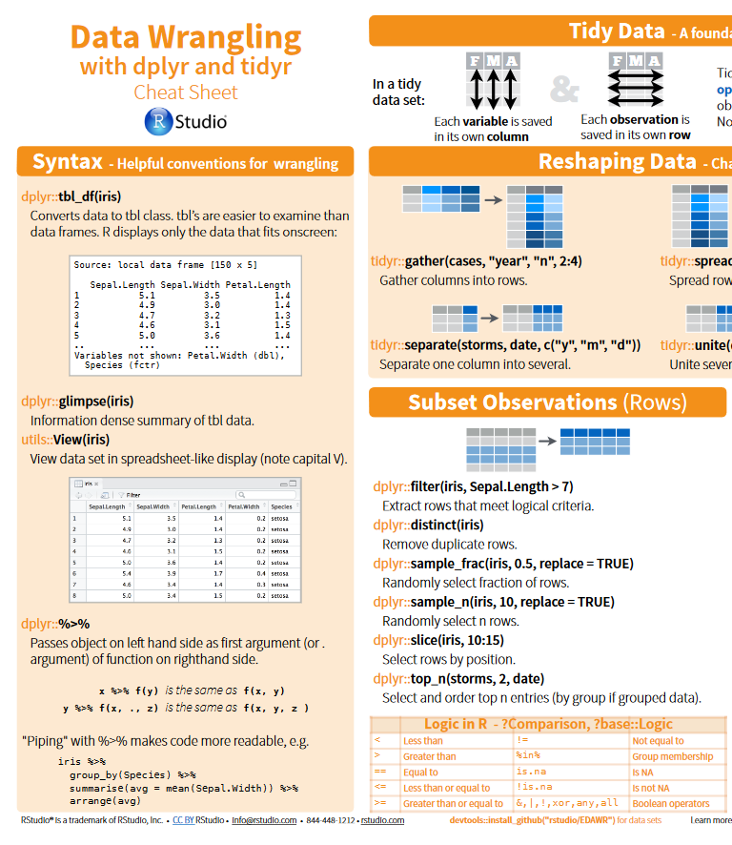
Cheatsheets
All cheatsheets
Getting started
dplyr and tidyr
Data import
lubridate
ggplot2
RStudio

Slide 73
Special Thanks
People who have taught & helped me or whose code I have shamelessly copied and learned from:
Franz Mueter (UAF)
All UAF classmates
Ben Williams (NOAA/ADF&G)
Jordan Watson (NOAA)
Curry Cunningham (UAF/NOAA)
Jenny Bryan (UBC)
Hadley Wickham (RStudio)
Greg Wilson (RStudio)
Allison Horst (RStudio)
Rhea Ehresmann (ADF&G)

